Slide 1
Mother Emmanuel-Marie de la Compassion (Marie Correnson)
Co-foundress of the Oblates of the Assumption (1842-1900) Presented via :
An object
A text she loved
Something she wrote
A place
2 portraits
A manuscript

Slide 2
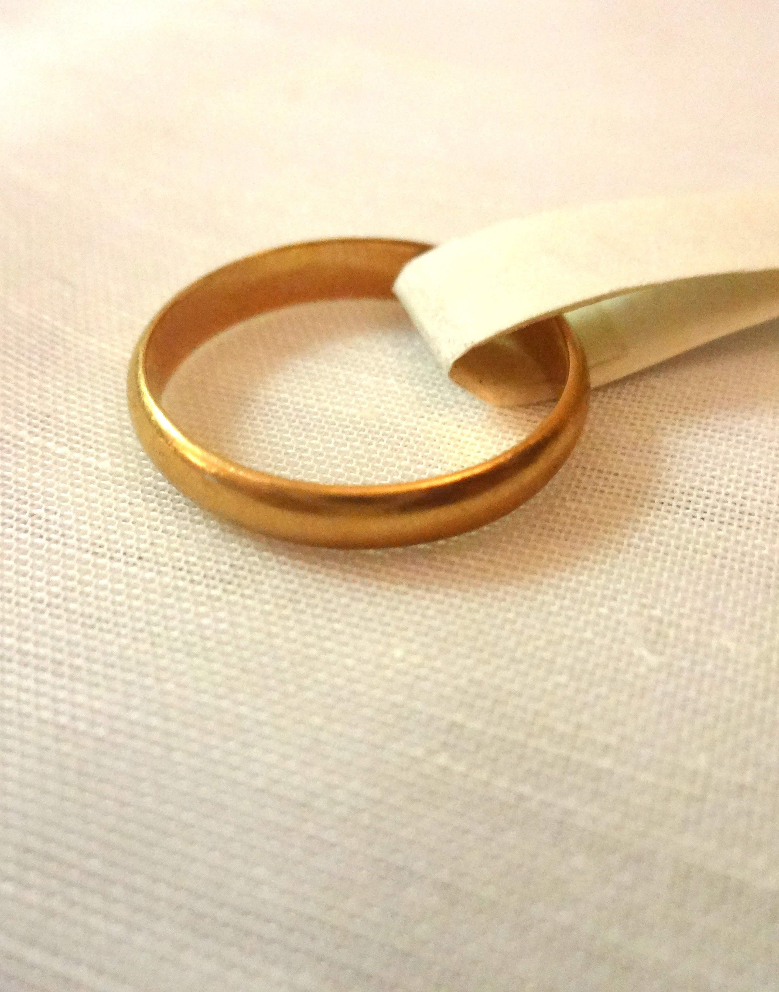
An object: the ring of her religious profession
Alliance ring offered by Father Emmanuel d’Alzon, on the day of her perpetual vows on April 18, 1868, after a year of novitiate in Rochebelle, Faubourg du Vigan (in the Cévennes), in the house where the Oblates were founded, on May 24, 1865. Father d’Alzon had the initials engraved on it: R.C.M.T.M.S.E.
« Rosa Cordis Mei Tu Mihi Sponsa Esto »
“Rose of My Heart be my Bride”
Words received from Saint Rose of Lima, a saint dear to her.

Slide 3
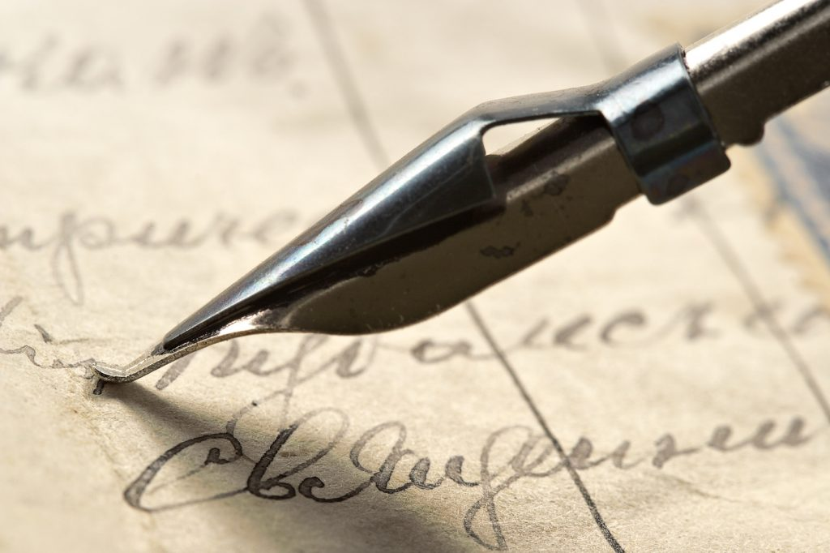
A writing she loves
Excerpt of a letter from Father d'Alzon from Rome, during the First Vatican Council (December 14, 1869)
"One senses that those for whom the Council is held are the friends of God, the little ones and the poor. Believe me, the power of the future is there. It is through poverty and humility that the world will be saved, if it can be. If anything could sadden me, it would be to see the work of the Oblates deviate. And if I can seek one of the reasons for my weakness for them, it is this humble spirit, more apt, it seems to me, to reach a part of the world that our lord loves especially.”
This text highlights the virtue of humility that the Oblate Sisters seek to cultivate, as well as their closeness to the poor and the little ones. The mention of the Council reminds us that Mother E-Marie Correnson was a daughter of the Church (Triple love of the Oblate Sisters: Christ, the Virgin, and the Church).

Slide 4
Excepts of her correspondence
Extract from a letter to Father E. d’Alzon, August 29, 1864 (she is 22 years old; he is her spiritual director)
I must therefore move quickly towards perfection; I know that I have much to do and that I must give myself to Our Lord more completely than I have done until today… Ask our Lord for me to have a great love for Him. I strongly feel that this is what I lack.
Extract from a letter to Mother Marguerite-Marie Chamska, on February 21, 1893 (she is 51 years old)
"How good God has been to us! What a Father! I am happy to belong to Him. I would like to give myself even more intimately, and yet I feel that I belong to Him entirely, yes, to Him alone, my God, now and forever."
Through these two letters, we perceive Marie's great desire to love the Lord and to belong to Him. We also see the work of a lifetime to achieve this. The second letter was written on the day Mother E-M learned from the Bishop of Nimes that Rome had signed the decree of praise recognizing the Congregation.

Slide 5
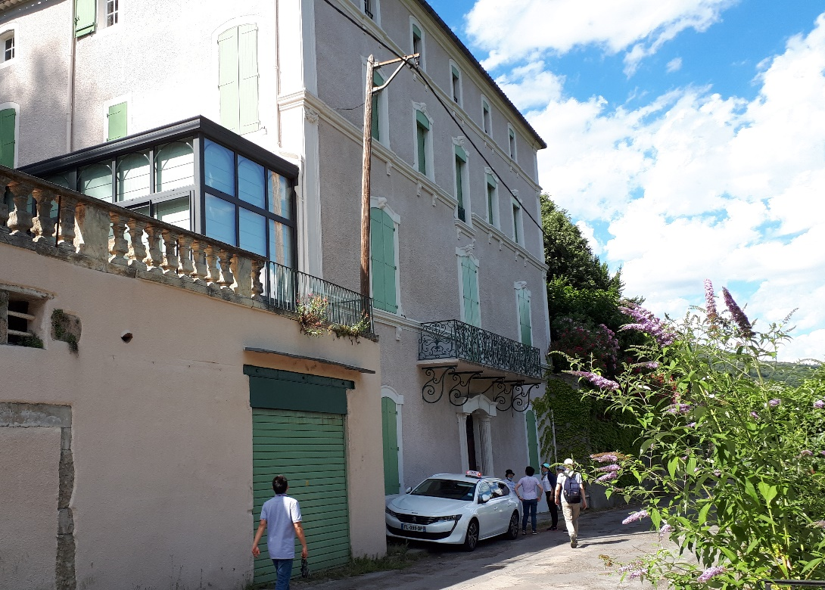
A place: the Community “Our Lady of Bulgaria” in Rochebelle, District of Vigan (Cévennes)
Place where the Congregation of the OA was founded on May 24, 1865
(Photo taken in July 2020)

Slide 6
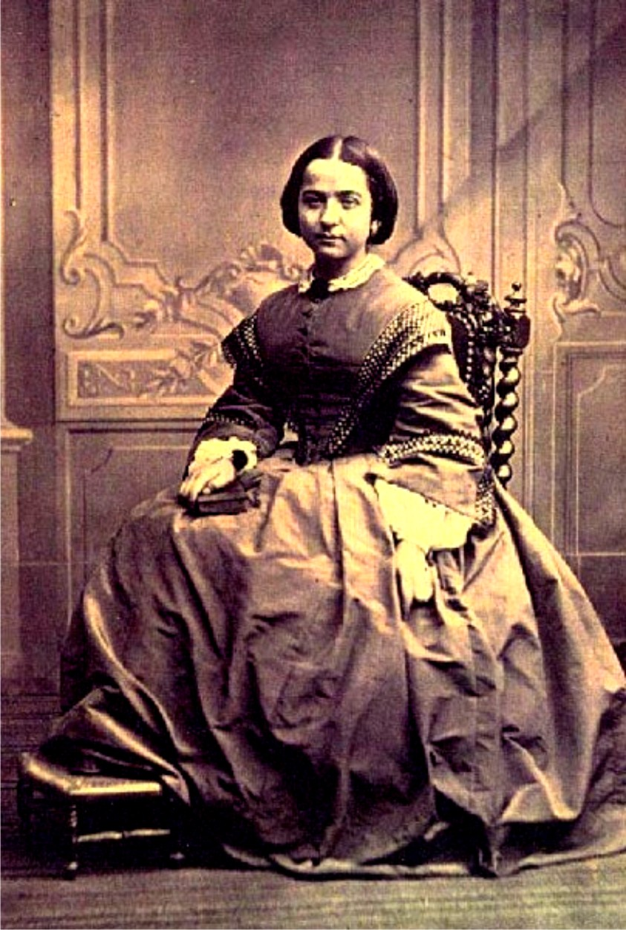
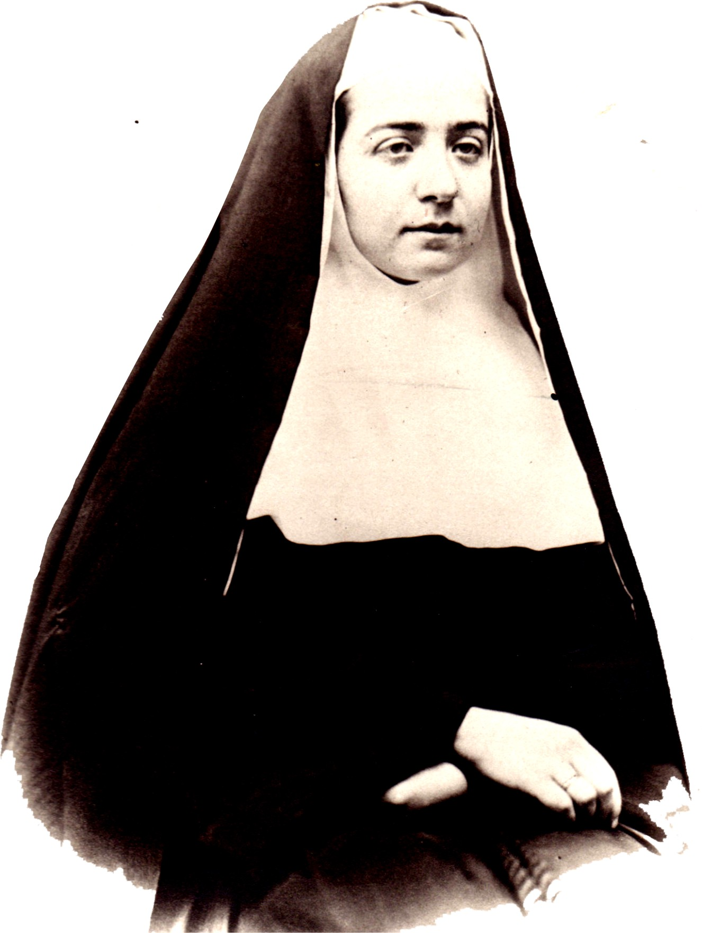
Two portraits of Marie Correnson
As a Young Sister
As a Postulant
Marie came from a bourgeois family in Nîmes, the daughter of a doctor. She was initially reluctant to mingle with the simple young women of the Cévennes countryside.

Slide 7
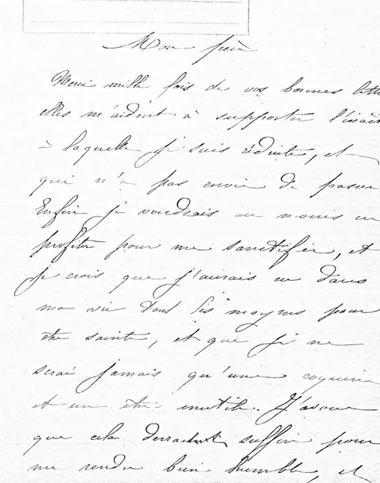
A handwritten letter:
Letter dated July 16, 1871, to Father E. d’Alzon

Slide 8
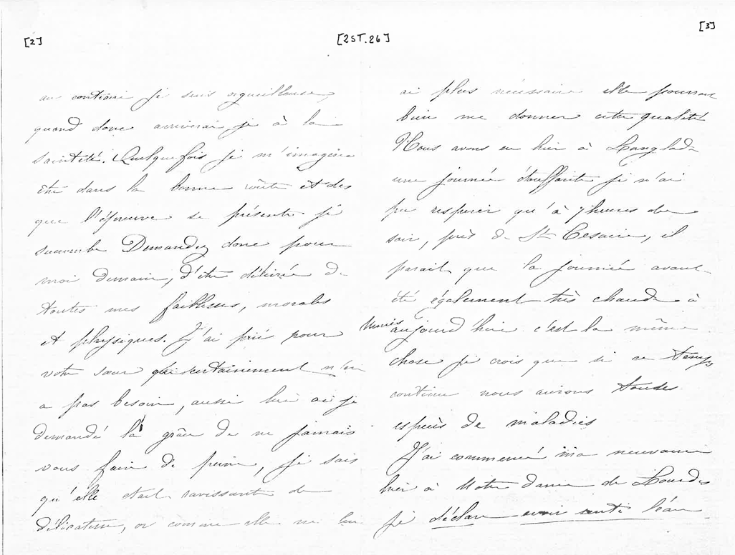
Continuation
of the letter dated
July 16, 1871

Slide 9
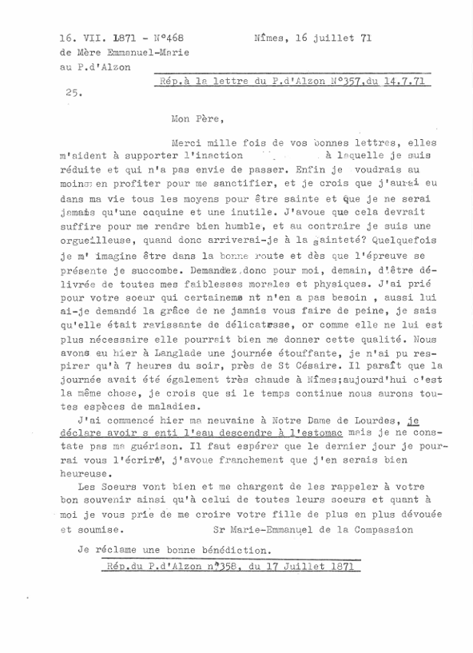
Typescript of the letter of July 16, 1871
In this letter we can see the fragile health of Mother Emmanuel Marie; her spiritual combat for holiness; the summer heat of Nimes and the popularity of Our Lady of Lourdes in 1871.

Slide 10
Author: Sr. Zoé, Oblate of the Assumption

